Slide 1

Data Warehousing
Data Science & analytics (it3080)

Slide 2
Overview
What is a data warehouse?
Architecture of a data warehouse
Dimension modelling
Logical design of a data warehouse
Implementing a data warehouse
Extract, Transform, Load (ETL)

Slide 3
Lesson Learning outcomes
Explain what a data warehouse is.
Compare traditional databases and data warehouses
Propose a logical design for a data warehouse to cater given business requirements
Explain the ETL Process
Explain the concept of slowly changing dimensions

Slide 4
What is a data warehouse?
A data warehouse is a integrated, subject-oriented, time-variant and non-volatile collection of data in support of management's decision making process.
  Integrated : A Data warehouse extracts data from many operational systems.
    Ex: Sales, Inventory, Payroll, Production
  Subject-oriented : A data warehouse can be used to analyze a particular subject area
  Time-Variant: data warehouses maintains historical data.
  Non-volatile : New data could be added to the data warehouses. However, existing data in the warehouse is not overwritten or updated.

Slide 5
What is a data warehouse? (contd.)
Historical data are stored in data warehouses. These data are queried for business intelligence or other analytical activities.
  Ex: What is the profitability of different products? What is the number of sales for each region for each product?
To answer such queries the data warehouse stores data in both atomic and summarized levels.
  Atomic level data to get more detailed information
  Pre-summarized data to speed up data retrievals

Slide 6
Why data warehouses?
Data warehouses provides an integrated and total view of the enterprise
OLTP databases does not perform very well for preparing reports where data should be queried from large number of tables.
Data warehouses are extremely quick in retrieving data due to its specialized data structure.
Data warehouses does not interfere with local processing at sources. While complex queries are run at warehouses OLTP queries are run at information sources.

Slide 7
Databases vs data warehouses
Databases | Data warehouse
Meant for OLTP | Meant for OLAP
Highly normalized with reduced redundancies. Faster insertions Slow in querying due to joins | Reduce the number of tables required for querying by deformalizing Redundancies may be high but yet acceptable due to speed of querying
Data is not standardized | Data is standardized
Current snapshot of data | Contains historical data
Should have minimal indexes to have speed in writing | Should have maximum indexing for read speed.

Slide 8
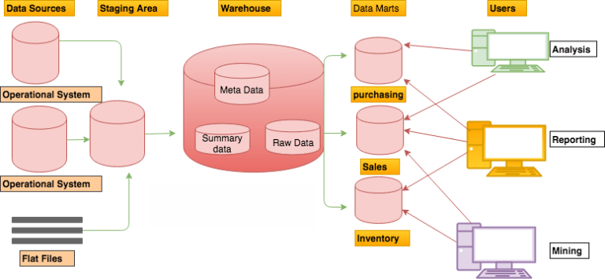
architecture of a data warehouse

Slide 9
architecture of a data warehouse (Contd.)
Data sources layer : The data source are from where original data are, collected from a variety internal and external sources.
Staging layer :
  The extracted data coming from several disparate sources needs to be changed, converted, and made ready in a format that is suitable to be stored for querying and analysis.
  Three major functions need to be performed for getting the data ready namely, extract the data, transform the data, and load the data into the data warehouse.
  These functions take place in a staging area.

Slide 10
architecture of a data warehouse (Contd.)
Storage layer : The data storage layer stores data that was cleansed in the staging area as a single central repository. Depending on the business the storage area may also contains data marts.
Presentation layer : The presentation layer provides users with the ability to query the data to gain insights and develop automated or ad-hoc reports.

Slide 11
Data warehouse vs data marts
Data warehouse: collects all information about subjects (customers,products,sales,assets, personnel) that span an entire organization
  Requires extensive business modeling (may take years to design and build)
Data Marts: Departmental subsets that focus on selected subjects
  Marketing data mart: customer, product, sales
  Faster roll out, but complex integration in the long run

Slide 12
Designing a data warehouse
In several ways, building a data warehouse is very different from building an operational system.
For an operational system, the users are able to give you precise details of the required functions, information content, and usage patterns.
However, for a data warehousing system, the users are generally unable to define their requirements clearly.
They cannot define precisely what information they really want from the data warehouse, nor can they express how they would like to use the information or process it.

Slide 13
Designing a data warehouse (contd.)
However, data warehouse users can provide very important insights into how they think about the business.
They are aware of what measurement units are important for them.
Each user department knows how they measure success in that particular department.
The users can also provide insights into how they combine the various pieces of information for strategic decision making.

Slide 14
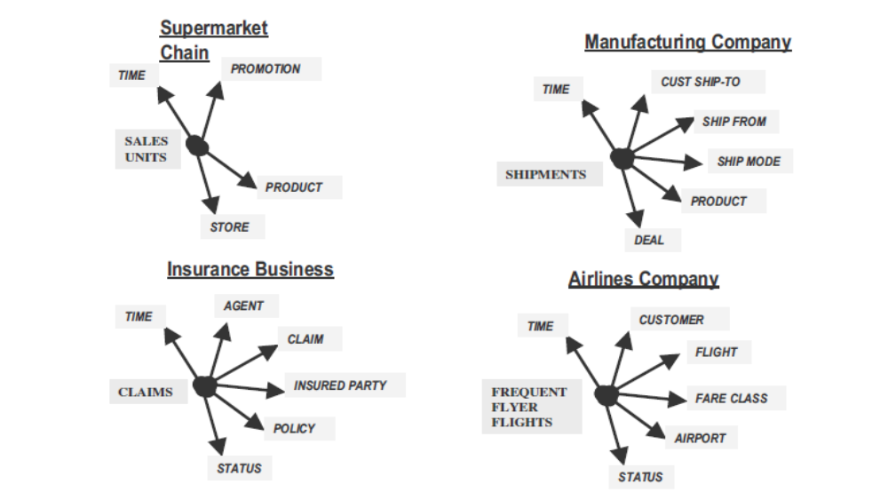
Dimensional nature of business data
Managers think of the business in terms of business dimensions.
  Ex: How much did a new product generate ? -> by months, user demographics, by sales location & etc.

Slide 15
Dimensional modelling
A Dimensional Model is a database structure that is optimized for online queries and Data Warehousing tools.
Dimensional modeling gets its name from the business dimensions which are need to incorporate into the logical data model of the data warehouse.
It is a logical design technique to structure the business dimensions and the metrics that are analyzed along these dimensions.
Dimensional Models are designed for reading, summarizing and analyzing numeric information, whereas Relational Models are optimized for adding and maintaining data using real-time operational systems.

Slide 16
Dimensional modelling (contd.)
In a data warehouse a dimension model is comprised of "fact" and "dimension" tables.
A fact table consists of facts of a particular business process. Facts are also known as measurements or metrics. A fact table record captures a measurement or a metric.
Dimension tables are used to represent business entities such as products, sales, people & etc. They contain attributes that provide context to the measures which will be used to for analysis.

Slide 17
Developing a dimensional model
Consider a subject to be analyzed (Ex: Sales)
These subjects are associated with a number of measured facts or the measurements that are of interest for analysis.
These measurements are to be analyzed along several dimensions.
  Ex: Facts → actual sales, forecast sales, and budget sales
  Dimensions →time, location, product, and demographic age group.
Each dimension are associated with several attributes. Attributes may have hierarchies among them

Slide 18
Attributes in dimensions
Attributes are basically the properties of the dimensions on which you wish to perform different analysis.
  Ex: Product Dimension : Name, color, size, price
Hierarchies are specification of levels that represents relationship between different attributes within a dimension
  Ex: Possible hierarchy in the Time dimension
    Year → Quarter → Month → Day
  Possible hierarchy in the Product dimension
    Category → Brand → Product

Slide 19
Measures of facts
A measure is an attribute in the fact table
It is a unit of analysis that you wish to perform on some data.
  Ex: In a sales Fact table you might find attributes such as sales amount, quantity sold, Sales price, tax, discount, profit, dealer price and actual cost.
Measures should be additive (i.e : statistical, financial and mathematical operations and aggregations could be performed on it)
  Ex: Phone number is not additive
Certain measures such as percentages are not additive, but yet considered as measures since they are still analyzable.
  Ex: Discount Percent, ratios such as Profit Margin

Slide 20
Granularity
The fact table grain is the business definition of what a single record represents at the most atomic level.
  i.e what is the lowest level the business users need to drill down to answer their questions
Typically, design tables to store the lowest grain possible
  For example, sales order line, or quarterly salesperson quota

Slide 21
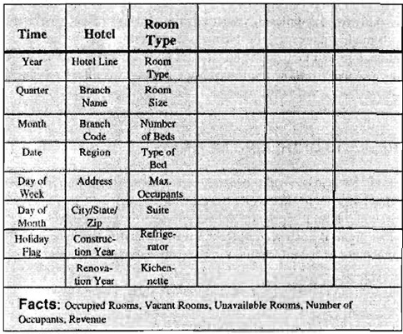
Ex: Hotel occupancy analysis
Dimensions
Attributes/ Hierarchies

Slide 22
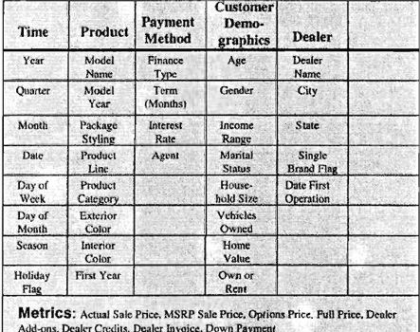
Another example
Dimensions
Attributes/ Hierarchies

Slide 23
Logical design of data warehouses
In data warehouses tables mentioned earlier are organized in specialized structures which is known as the schema.
Following are three such schemas
  Star schema: One fact table and a set of dimension tables
  Snowflake schema: Avoids redundancy of star schemas by normalizing dimension tables
  Constellation schema: Multiple fact tables that share dimension tables

Slide 24
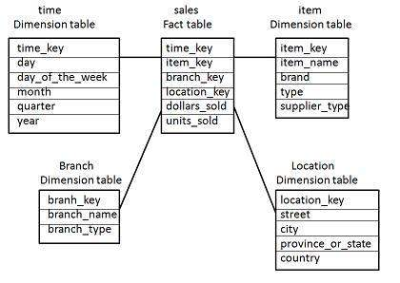
Star schema
The star schema is the simplest data warehouse schema.
The schema consists of one fact table and a set of dimension tables.
  There are referential integrity constraints between fact table and dimension tables
Dimension tables may contain redundancies
It is called star schema because the structure of star schema resembles a star.

Slide 25
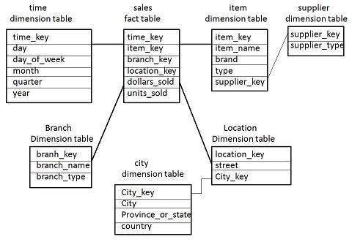
Snowflake schema
Snowflake schema is an extension of star schema means it is more complex than star schema.
In star schema each dimension is represented by a single dimension table whereas in snowflake schema each dimension is grouped into multiple lookup tables to eliminate the redundancies.
Normalized tables optimize storage space, but it may decrease performance

Slide 26
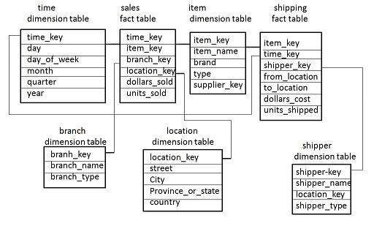
Fact Constellation Schema
A fact constellation has multiple fact tables. It is also known as galaxy schema.

Slide 27
Advantages of star schema
Easy to understand
Delivers higher performance queries
  Fewer table joins
  Higher likelihood of using indexes
Optimizes navigation
Requires low maintenance as the data warehouse evolve

Slide 28
Primary keys in dimension tables
Each row in a dimension table is identified by a unique value of an attribute designated as the primary key of the dimension.
  For example, in a product dimension table, the primary key identifies each product, uniquely.
However, it is recommended not to use following fields as primary keys
  avoid built-in meanings in the primary key of the dimension tables
  avoid using fields which are re-assigned as primary keys
In a situation where the above cannot be met, surrogate keys could be used. The surrogate keys are simply system-generated sequence numbers (Can be implemented using identity property)

Slide 29
Foreign keys
Each dimension table is in a one-to-many relationship with the central fact table.
So the primary key of each dimension table must be a foreign key in the fact table.
If there are four dimension tables of product, date, customer, and sales representative, then the primary key of each of these four tables must be present in the orders fact table as foreign keys.

Slide 30
Primary key of fact tables
Following options could be used
  Concatenate all the primary keys of the dimension tables. The individual parts of the primary keys are foreign keys.
  Use a generated primary key independent of the keys of the dimension tables. In addition to the generated primary key, the foreign keys must also be kept in the fact table as additional attributes. This option increases the size of the fact table.

Slide 31
Exercise
A company manufactures products and sell them in different stores. Each product manufactured has a product Id, a name, unit price and belongs to a category. The products manufactured are stored at different stores across the country. Each store has a store id and a location. The company is interested of knowing following
  What day of the week has highest number of sales for a certain product
  Which month has the highest income for the store for a certain product
  Which store has the highest number of total sales
  Which province has the highest income made of a certain product
  Which city provides the highest income to the company within the year
  What is the weekly income of each store
Develop a star schema to cater the above requirements

Slide 32
Maintaining historical data
OLTP systems does not usually store historical data.
  When an update is needed previous data is overridden immediately.
    For example if a place of work of a sales clerk in the same company changes his location attribute value is usually overridden
    Comparison of his performance is then not possible location wise
When OLTP data is loaded to the data warehouse, changes to existing data are organized.

Slide 33
Slowly changing dimensions
Slowing changing dimensions(SCD) are used to maintain historical context in data flowing in to the data warehouse.
SCD are known as dimensions which contains slowly changing dimension attributes
  Slowly Changing Dimension Attribute – an attribute of a record in a dimension table that varies over time, unpredictably
Many different types of SCDs are available including, SCD type 0 to SCD type 6
  In most implementations SCD type 1,2 and 3 are used.

Slide 34
SCD type 1
Simplest form of SCD
  Does not store any historical data
  Overwrites existing data with new values
  Ex:
Employee | Before | After
ID | 2728 | 2728
Name | James Gold | James Gold
SalesRegion | New York | Seattle
Gender | M | M
MaritalStatus | Single | Married

Slide 35
SCD type 2
Creates a new record for new values
Old record is denoted using the End Date attribute
Ex:
Employee | Before | After
ID | 1067 | 1067 | 1482
Original ID | 2728 | 2728 | 2728
Name | James Gold | James Gold | James Gold
SalesRegion | New York | New York | Seattle
Gender | M | M | M
MaritalStatus | Single | Single | Married
Start Date | 2014-03-01 | 2014-03-01 | 2014-11-25
End Date |  | 2014-11-25

Slide 36
SCD type 3
Used to store historical data only for specific columns
Only limited history can be maintained
Usually for one previous change only
Ex:
Employee | Before | After
ID | 2728 | 2728
Name | James Gold | James Gold
SalesRegion | New York | Seattle
SalesRegion Previous |  | New York
Gender | M | M
MaritalStatus | Single | Single
EffectiveDate | 2014-03-01 | 2014-11-25

Slide 37
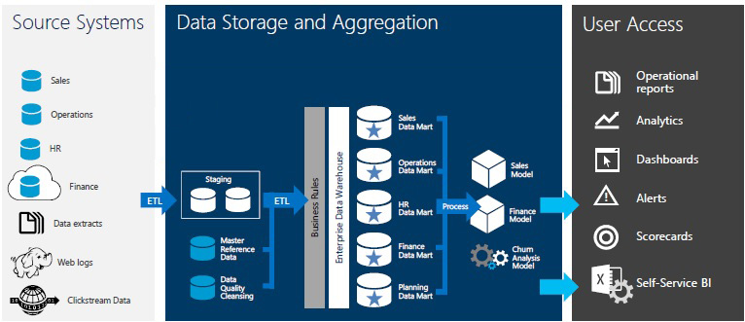
Implementing a data warehouse using SQL Server

Slide 38
Enterprise information management
“Enterprise Information Management (EIM) is a best practice for creating, managing, sharing, and leveraging information in an enterprise, holistic manner that’s aligned with strategic, data-driven business objectives.”
It is concerned of following aspect of data
  Complete, Clean, Consistent, Current

Slide 39
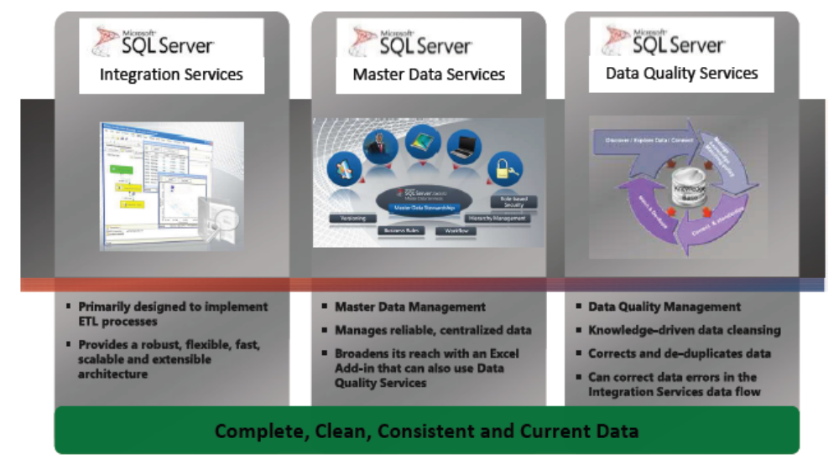
SQL Server eim services

Slide 40
ETL (extract, transform, load)
Mostly, the information contained in a warehouse flows from the same operational systems that could not be directly used to provide strategic information.
ETL refers to a set of functions that fall under the broad group of data extraction, transformation, and loading.
ETL functions reshape the relevant data from the source systems into useful information to be stored in the data warehouse.
Without these functions, there would be no strategic information in the data warehouse.
ETL is used to populate dimension and fact tables, in effect to synchronize data between source systems and the data warehouse

Slide 41
ETL (Contd.)
Common challenges:
  Retrieving and integrating data from multiple sources
  Cleansing and transforming the data
  Loading the data into appropriate data stores for analysis and reporting
Enterprises spend 60%–80% of their resources developing, testing and maintaining their ETL processes
ETL processes usually require dedicated monitoring and maintenance

Slide 42
SQL sever integration service(ssis)
SQL Server Integration Service(SSIS) component performs ETL processes to load data from different sources to data warehouse.
  SSIS is optimized for working with SQL sever data
  However, it can also work with other data sources as well as destinations
  SSIS provides a number of components for processes as well as data transformations
    Most of those could be done without any code

Slide 43
SSIS package
A SSIS package is the object that implements Integration Services functionality to extract, transform, and load data.
A basic package includes the following elements:
  Control flow elements :These required elements perform various functions, provide structure, and control the order in which elements run.
  Data flow elements : These optional elements extract data, modify data, and load data into data sources.

Slide 44
SSIS Control flow
Control flow is the process-oriented workflow engine
A SSIS package consists of a single control flow
The main control flow elements are tasks, containers, and precedence constraints. There must be at least one control flow element in a package.

Slide 45
CONTROL flow elements - containers
Provide structure and services for:
  Grouping tasks
  Implementing repeating flows
Ex: For Loop Container, Foreach Loop Container, Sequence Container

Slide 46
CONTROL flow elements - tasks
Perform discrete operations in packages
Data Flow Tasks
Data Preparation
Process Communication
Execute SQL
Analysis Services
Scripting
Miscellaneous

Slide 47
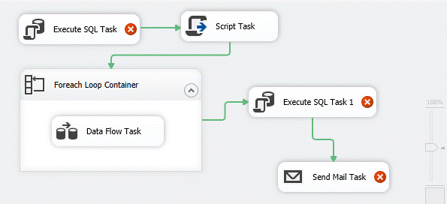
Control Flow – an Example

Slide 48
CONTROL flow elements - tasks
Perform discrete operations in packages
  Data Flow Tasks : defines and runs data flows that extract data, apply transformations, and load data.
  Data Preparation : copy files and directories, download files and data, save data returned by Web methods, or work with XML documents
  Workflow tasks : communicate with other processes to run packages or programs, send and receive messages between packages, send e-mail messages
  Execute SQL tasks : access, copy, insert, delete, or modify SQL Server objects and data.
  Scripting tasks: extend package functionality through custom scripts.

Slide 49
CONTROL flow elements - Precedence constraints
Link containers and tasks to control the order of execution
Configure conditions that determine whether the constrained
executable runs:
  Success, Failure, or Completion constraints
  Expressions
  Logical AND/OR for multiple constraints

Slide 50
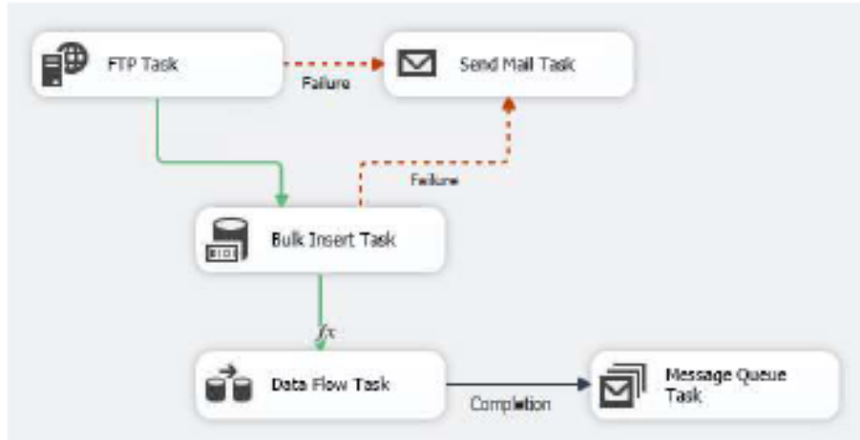
CONTROL flow elements - Precedence constraints

Slide 51
SSIS data flow
Data flow is assembled from components:
  Sources that extract data : relational tables, views, files
  Destinations that load data : relational tables, views, rowsets, recordsets
  Transformations that modify data
Paths connect the data flow components to create a pipeline
At design time Data Viewers can be attached to the service paths to visualize the data flowing through a path

Slide 52
Transformations
Common transformations
  Aggregate : Aggregate transformation allows to aggregate data from Data Flow
  Data Conversion : Performs a similar function to the Convert or Cast functions in T-SQL
  Derived columns : Creates a new column that is derived from the output of another column.
  Lookup : Compares source data with existing table dataset and filters matching ones and un-matching ones
  Merge : Combines two sorted datasets into a single dataset

Slide 53

Thank You

